Slide 1





NSGA-II optimizer-based CNN-LSTM prediction model for Inventory Demand Forecasting
TG20210000200
Photo
(Author 1)
Photo
(Author 2)
Photo
(Author 3)
Photo
(Author 4)
Karthik K
Nithin Soundar S J
Ram Prasanth
N
Rithick Roshan R
Sri Ramakrishna Engineering College
Coimbatore, Tamil Nadu
Mentor: Mr. T. Rajasekar
Notes:
Title Text Font Calibri Body Bold, Font Size 34, Name and Designation Font Size 18

Slide 2


Index
Challenge Statement
Concept of the Solution
Novelty / Scope of Solution
Pros and Cons of the solution
Technical Description
Implementation Plan
Validation/Testing/Analysis
Cost Estimate
9
Assumptions
10
References
00200

Slide 3
A Technical Presentation:
A NSGA-II optimizer-based CNN-LSTM prediction model for Inventory Demand Forecasting

Slide 4
Challenge Statement
Airlines face major expense in replacement of serviceable parts such as wheels at any airport due to unexpected damage.
The challenge statement expects the solution to predict the time window for the replacement of aircraft wheels to be maintained at a particular station.
The solution must take into factor all the parameters such as weather, temperature variation, runway quality at a station and also different aircraft types and their life cycles, as they can influence the damage to the tyres.
Since neither overstocking nor understocking have a negative impact, accuracy must be the primary concern.
The preferred solution is a AI model that predicts the time window of the replacement with a dashboard as the front end.
00200

Slide 5
Concept of the solution
The concept of the solution is
To develop a AI model that can predict the time window for the wheel replacement parts. The wheel replacement details can be input in any of the stations in the web server.
In the process of building the CNN-LSTM model, NSGA-II (Nondominated Sorting Genetic Algorithm), a multi-objective genetic algorithm, is used to optimize primary parameters such as reduce RMSE and increase Accuracy.
To develop a dashboard where users can create, update and delete aircraft models, wheel replacement details and so on.
A web server hosted on cloud to connect all the users through internet, permissions can be granted or revoked from an administrative dashboard.
00200

Slide 6
Novelty / Scope of Solution
To the best of our knowledge, this is the first study to blend NSGA-II optimizer with a CNN-LSTM model
Root Mean Square Error and Accuracy are optimized with the multi-objective genetic algorithm NSGA-II(Nondominated Sorting Genetic Algorithm).
Another novelty of the solution is the usage of synthetic data. This is due to fact that the data available on the airlines is relatively smaller.
The algorithmic bias that occurs due to synthesising data is overcome by data augmentation.
Since every request for access goes through the server it is very secure and any changes are effected immediately.
00200

Slide 7
Pros and Cons of the solution
What are the advantages of demand forecasting?
Demand forecasting helps
Reduce risks
Make efficient financial decisions that impact
profit margins
cash flow
opportunities for expansion
operating costs
staffing
overall spend
What are the disadvantages of forecasting?
Forecasts are Never Completely Accurate - Forecasts are never 100% and it is almost impossible to predict the future with certainty.
00200

Slide 8
Technical Description
The components of the solution are:
AI Model consists of a NSGA-II optimizer and a CNN-LSTM algorithm. Adding convolutional layers to capture local, temporal patterns on top of LSTM layers can be immensely helpful.
Web Server built using the Spring Framework containing the AI Model, which can be easily deployed on to either Azure or AWS.
Dashboard (web application) built using Spring MVC Web Container, Thymeleaf and AngularJS for the administrator, providing creation, management, modification and revocation of users/visitors/roles/permission etc.
00200

Slide 9
Detailed Description
A. AI Model
The AI model containing the NSGA-II Optimizer with CNN-LSTM combines the advantages of both Convolutional Neural Network and Long Short-Term Memory Neural Networks to predict the time window for wheel replacement.
The Non-Dominant Sorting Genetic Algorithm is a fast, efficient convergence algorithm used to search in a wide range and handle problems that start with non feasible solutions.
It is a fast sorting and elite multi-objective genetic algorithm that is used to reduce Root Mean Square Error and increase Accuracy.
For time series forecasting, the LSTM and CNN are combined, where LSTM performs series of tasks and CNN layer process through the use of dilated convolution.
CNN is used to extract time features of data and LSTM is used for data forecasting.
00200

Slide 10
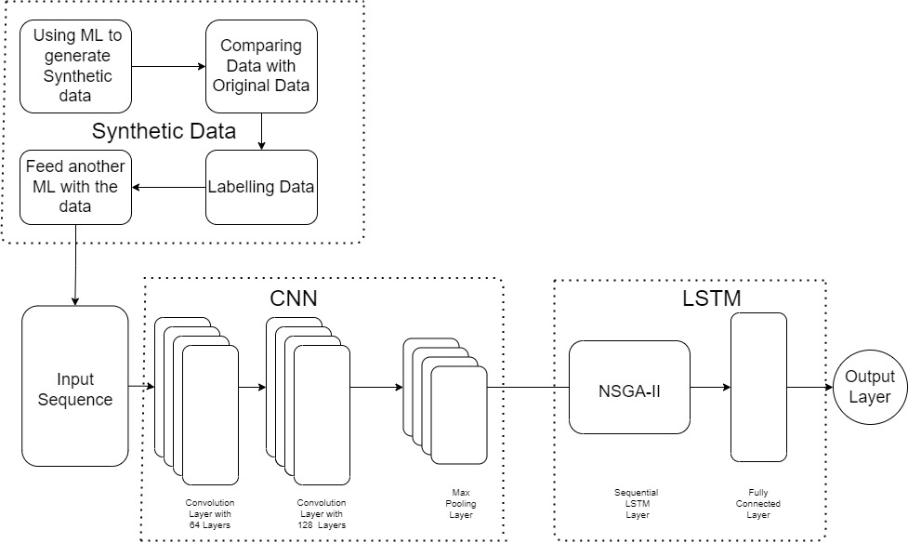
Detailed Description
A. AI Model
00200

Slide 11
Detailed Description
B. Web Server
The web server is built using Spring Framework while bearing in mind industry standard.
The server will be deployed on a cloud service provider either Azure or AWS.
00200

Slide 12
Detailed Description
C. Dashboard
The Dashboard is built using Spring MVC Container, AngularJS and Thymeleaf.
The dashboard can be accessed via a web browser.
The aim of providing a dashboard is to lively and swiftly make changes to the system remotely.
The dashboard will support user actions for:
Creation, Deletion and Updation of Aircraft Models.
Creation, Deletion and Updation of Wheel replacement details.
The dashboard will support administrator actions for:
Creation, Deletion and Updation of user permissions.
00200

Slide 13
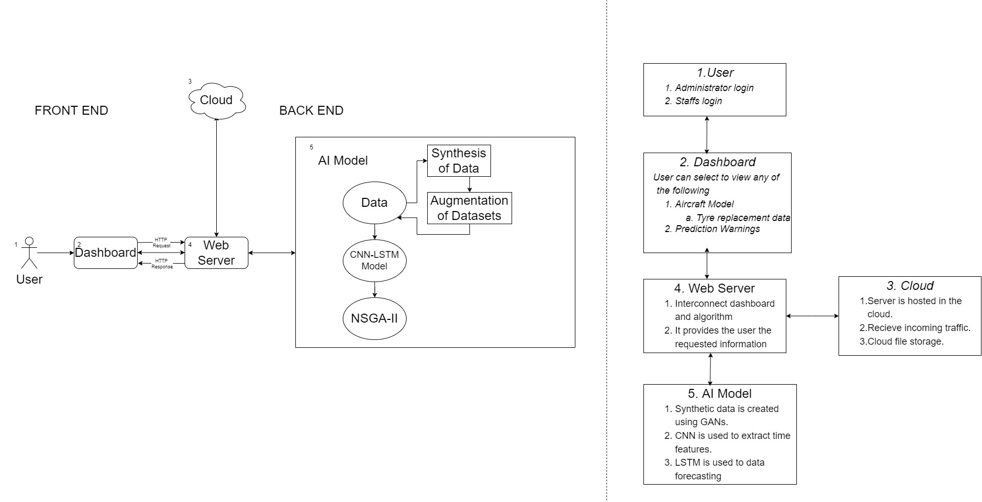
Analytical Solution
00200

Slide 14
Implementation Plan
AI Model
Synthetic data.
NSGA-II CNN LSTM algorithm.
Web server
Deployment to cloud
Dashboard
User role control.
Administrator role control
00200

Slide 15
Validation / Testing / Analysis
The model is evaluated using parameters such as accuracy, precision, f-score and recall.
The link between Server and web browser is a secure TLS(Transport Layer Security), the upgraded version of SSL, encrypted connection.
Synthetic data is only 70% accurate than original data due to the negligence of outliers. So, we use augmentation of data.
The server is tested for vulnerabilities using DDoS, MITM, TLS.
00200

Slide 16
Cost Estimate
SI.NO | ITEM | COST(in INR)
1 | TLS Encryption | 2000
2 | Cloud Service | 500
 | Total | 2500
00200

Slide 17
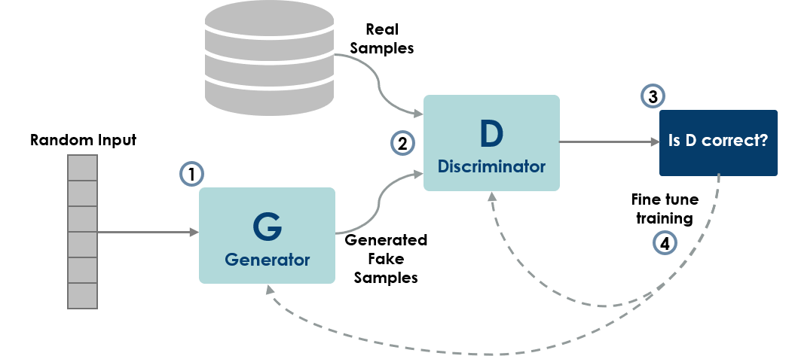
Assumptions
Due to the fact that synthetic data is nothing but merely the creation of fake data and then comparing with the real data, this very idea of synthetic data is an assumption.
00200

Slide 18
References
Nor Atiqah Zolpakar and Swati , “Application of Multi-objective Genetic Algorithm (MOGA) Optimization in Machining Processes”.
You Ji, Shiliang Sun, “Feature selection for ensembles using Non-dominated Sorting in Genetic Algorithms” 2010 Sixth International Conference on Natural Computation, Publisher: IEEE
Sakorn Mekruksavanich and Anuchit Jitpattanakul, “A Multichannel CNN-LSTM Network for Daily Activity Recognition using Smartwatch Sensor Data”. 2021 Joint International Conference on Digital Arts, Media and Technology with ECTI Northern Section Conference on Electrical, Electronics, Computer and Telecommunication Engineering, Publisher: IEEE
00200

Slide 19


THANK YOU

